Slide 1
How to Design an Experiment: Part II
Experimental psychology
guided-inquiry learning
Module: How to Design an Experiment: Part II
© 2021, Dr. B. Rumain & Dr. A. Geliebter, Touro College & University System

Slide 2
Learning Objectives
You will consider an experiment where there are three levels of one independent variable (IV).
Using an independent variable (IV) of dosage, you will determine the smallest dose that is effective.
You will consider an experiment where there are two dependent variables.

Slide 3
Vocabulary
Multivariate

Slide 4
Motivation
We know that Elate does better than placebo from the previous study. In the previous study (Scenario #1), we gave patients either placebo or 1200 mg of Elate once daily.
But would a smaller dose of Elate be equally effective? What about if we gave 750 mg once daily?
2 levels of the independent variable
(Dosage)
Control Group
Experimental Group
1200 mg
0 mg

Slide 5
Motivation
If that dose worked equally well it would be the optimal dose since it involves getting the same benefit without ingesting more medication. (More medication can mean more side effects.)
Below is a study with 60 patients to test the optimal dosage.

Slide 6
Information
Scenario #2:
In the current study, we divide our group of 60 patients into three equal groups of 20 each. We give 750 mg Elate to one of the groups, 1200 mg to a second group and a placebo (0 mg Elate) to the third group as follows.
3 levels of the independent variable
(Dosage)
Experimental Group I
Experimental Group II
Control Group
750 mg
1200 mg
0 mg

Slide 7
Information
At the end of the two weeks, the patients are each again rated by the psychiatrist for their number of symptoms of depression. For each group, we then calculate the average number of symptoms of depression for all 3 groups. See Table 1 below:
Table 1: Average Number of Symptoms of Depression after 2 Weeks as a Function of Group
Treatment Group | Average Number of Symptoms of Depression after 2 Weeks as Determined During Patient’s Interview with a Psychiatrist
750 mg Elate (Experimental Group I) | 2
1200 mg Elate (Experimental Group II) | 2
0 mg Elate (Control Group) | 5

Slide 8
Exercises
In what way do Experimental Groups I and II differ?
What is the dependent variable?
Do the patients getting Elate do better in terms of depressive symptoms than those getting placebo? Can we conclude that Elate is effective against depression?
4. (a)Was there a difference in the average number of symptoms of depression between Groups I and II?
(b) Based on this finding, what can we conclude? What is the least dose of Elate that is effective? Why is it good to use the smallest dose that is effective when treating patients?

Slide 9
Exercises
In any experiment, there must be at least two levels of the independent variable. Why is this statement true?
In addition to the psychiatrist ratings, we could also have patients rate themselves in terms of how depressed they feel. One such instrument that allows patients to rate themselves is the Beck Depression Inventory.
(a) If we had patient self-ratings, what type of variable would this be? Would it be an Independent, Dependent, or Control variable?
(b) So, in this case, how many dependent variables would we have in total? Name them.

Slide 10
Multivariate
We can diagram this as follows:
A study where there is more than one independent variable and/or more than one dependent variable is called multivariate. The study above, with two dependent variables, is a multivariate study.
Could use both measures =
2 dependent variables
Beck Depression Inventory
- Patient self-rating
Clinical Interview
- Clinician rating

Slide 11
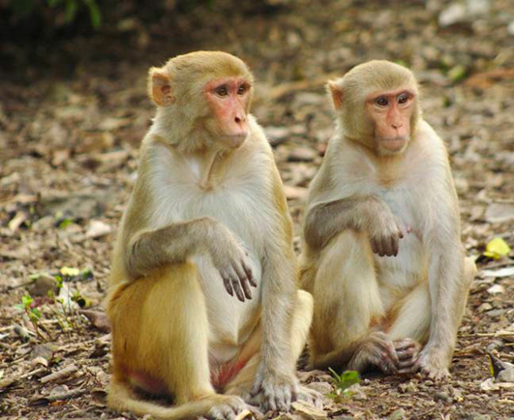
Problem
Nine rhesus macaque monkeys were infected with a strain of the coronavirus in an attempt to find a solution to the Wuhan epidemic. The monkeys were exposed to Middle East respiratory syndrome coronavirus (MERS-CoV) - a strain which can cause a cough, shortness of breath, a fever and, in some cases, organ failure, according to the World Health Organization.

Slide 12
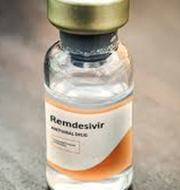
Problem (continued)
Scientists were interested in seeing whether an experimental drug they developed, called remdesivir, proved effective in treating the infected animals. In the first experiment, the efficacy of prophylactic remdesivir treatment was tested in one group of six rhesus macaques treated with remdesivir in vehicle solution (water and hydrochloric acid solution, pH3.5) and three control rhesus macaques who received the same volume of vehicle solution. Treatment was initiated at 24 h before the monkeys were inoculated with the coronavirus and continued once daily until 6 days post infection (6dpi). The results were that the macaques who were treated with remdesivir showed no symptoms whereas those that received just the vehicle solution did show symptoms of the coronavirus.

Slide 13
Exercises
How many monkeys were involved in the study? The number of subjects/participants is known as the sample size.
What does “prophylactic” (par. 2, line 3) mean? Look it up. Explain why the word is being used here.
(a) What is the independent variable? (b) How many levels are there of the independent variable? (c) Name them.
What is the Experimental Group? the Control Group? How many subjects (monkeys) were in each group?
What was done to the Control Group? What sort of placebo did they get?
Control variables are factors in the experiment, other than the independent variable(s) that the experimenter keeps constant. Control variables, therefore, are different from the “control condition” even though they both contain the word “control.”
(a)Why is it important to keep all other variables constant except for the one(s) you’re investigating?
(b) What might be some control variables in the experiment described here? List them.
What is the dependent variable?
What were the results?

