Slide 1
How to Design an Experiment: Part III
The Case of 2 Independent Variables (IVs) = a “2-factorial design”
Experimental psychology
guided-inquiry learning
Module: How to Design an Experiment: Part III
© 2021, Dr. B. Rumain & Dr. A. Geliebter, Touro College & University System

Slide 2
Motivation
Suppose you feel that medication is not the full story when it comes to relief from depression.
Suppose you think that medication can be effective but that people can also find relief from depressive symptoms by exercising, and you’d like to test out that idea.
You want to look at the effect of exercise in addition to the effect of medication.
How would you set up the experiment?

Slide 3
Learning Objectives
You will consider an experiment where there are 2 independent variables (aka, 2 factors).
You will learn how to set up a Latin Square.
You will be able to design an experiment where 2 factors are involved.

Slide 4
Vocabulary
Factors
2-factorial design
Latin Square
Randomized = random assignment
Subject variable

Slide 5


Information
To do the experiment, we could have 2 independent variables as follows:
Independent variable #1:
Dosage
3 levels:
750mg (experimental group #1)
1200mg (experimental group #2)
0mg (control group)
Independent variable #2:
Exercise
2 levels:
“Yes exercise”
“No exercise”

Slide 6
Exercises
What are the 2 independent variables (IVs)?
  These 2 IVs are called “2 factors” and the design is called a “2-factorial design.”
2. What are the levels of each IV?
  Levels of IV #1:_____________
  Levels of IV #2:_____________
So, based on the above, how many groups of subjects are there? How did you calculate that?

Slide 7
Exercises (continued)
4. Fill in what the groups are in the following table:
This table is called a Latin Square. To get all the groups (conditions), we multiply the levels of one IV by the levels of the other IV.
5. Doing the multiplication here we get ___x___=___ conditions.
6. For each independent variable, what is the control group?
Independent Variable #1: Dosage
 | 750mg | 1200mg | 0mg
Yes
No
Independent
Variable #2:
Exercise

Slide 8
If your Latin Square looks like the one below, then you are correct:
Independent Variable #1: Dosage
 | 750mg | 1200mg | 0mg
Yes | Group 1: 750mg and Yes Exercise | Group 2: 1200mg and Yes Exercise | Group 3: 0mg and Yes Exercise
No | Group 4: 750mg and No Exercise | Group 5: 1200mg and No Exercise | Group 6: 0mg and No Exercise
Independent
Variable #2:
Exercise

Slide 9
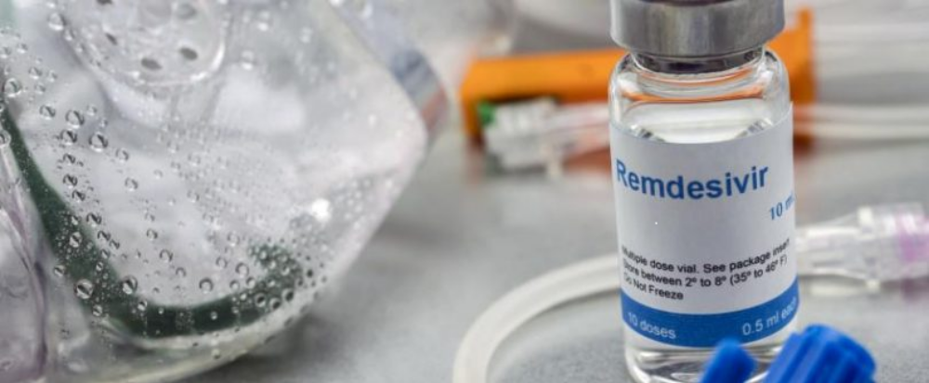
Problem
China has started a clinical trial to speedily test a drug for the novel coronavirus infection that has already killed so many. Remdesivir, a new antiviral drug by Gilead Sciences Inc. aimed at infectious diseases such Ebola and SARS, will be tested by a medical team from Beijing-based China-Japan Friendship Hospital for its effectiveness in treating the deadly new strain of coronavirus.
Trials for the drug will be conducted in the central Chinese city of Wuhan. 270 patients with mild and moderate pneumonia caused by the virus will be recruited in a randomized, double-blinded and placebo-controlled study. Patients will get 10 once-daily infusions of the experimental drug or a placebo and be evaluated after 28 days to see whether the drug helped. Chinese hospitals will be in charge of conducting the tests.

Slide 10
Problem (continued)
What are the IVs in this study?
How many levels are there of each IV? Identify the levels.
3. Draw a Latin Square and fill it in so as to determine how many conditions (groups) there will be. How many conditions are there?
4. How many subjects will get the drug and how many the placebo?
5. Explain what the description “randomized, double-blinded and placebo-controlled study” means.
Randomized is also referred to as “random assignment.” What that means is that we randomly assign subjects to the different conditions.

Slide 11
Problem (continued)
6. As you probably noticed, the IV of severity of sickness (with 2 levels: mild, moderate) is not the same sort of IV as dosage.
In what way?
It’s not the same because you can’t randomly assign people to have mild or moderate illness in the way that you can assign subjects to either get 1200 mg of medicine or 750 mg of a medicine in the Elate study.
Such a variable is really a Subject Variable although we will treat it as an IV. It is a subject variable because it is a characteristic of the subject. Other subject variables are gender, age, race. For example, if someone is 30-years-old they can’t be assigned to the 50 year-old-group.

