Slide 1
Memory and Priming: Meyer and Schvaneveldt’s Lexical Decision Task
Experimental psychology
guided-inquiry learning
Module: Memory and Priming: Meyer and Schvaneveldt’s Lexical Decision Task
©2017, Dr. B. Rumain & Dr. A. Geliebter, Touro College & University System

Slide 2
MOTIVATION
Did you know that images of faces/eyes can affect our honesty (by increasing it)?
Consider the following British study which took place in an office kitchen where people were supposed to pay for taking coffee and tea. They were on their honor to pay the suggested prices from the price list.

Slide 3
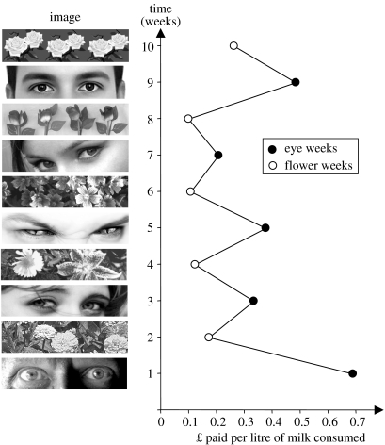
Above the price list, researchers posted a new image each week for ten weeks. They alternated between images of flowers and images of human eyes.

Slide 4
As can be seen from the graph, when people were primed by seeing the eyes, they paid roughly three times as much as when the flowers were there.
Why?

Slide 5
The reason is that the image of a face primes us to think of someone watching, which prompts us to act more honestly.
The first studies on priming were done using words, not images, but the same principles apply.

Slide 6
LEARNING OBJECTIVES
You will be able to define the priming effect.
You will be able to define a lexical decision task.
You will be able to understand and derive information from the table showing Meyer and Schvaneveldt’s findings.

Slide 7
INFORMATION
Model
The priming effect refers to the fact that exposure to certain words could encourage the recognition of related words more easily.
Do the Lexical Decision Task in Psychmate.

Slide 8
Experiment I
This priming effect was first demonstrated in a study by Meyer and Schvaneveldt on a lexical decision task (deciding if some string of letters was a word or not).
In Meyer and Schvaneveldt’s task, subjects were presented with two strings of letters, one centered on top of the other. If both strings were words, subjects were to press a “yes” key; in all other cases, they were to press a “no” key.

Slide 9
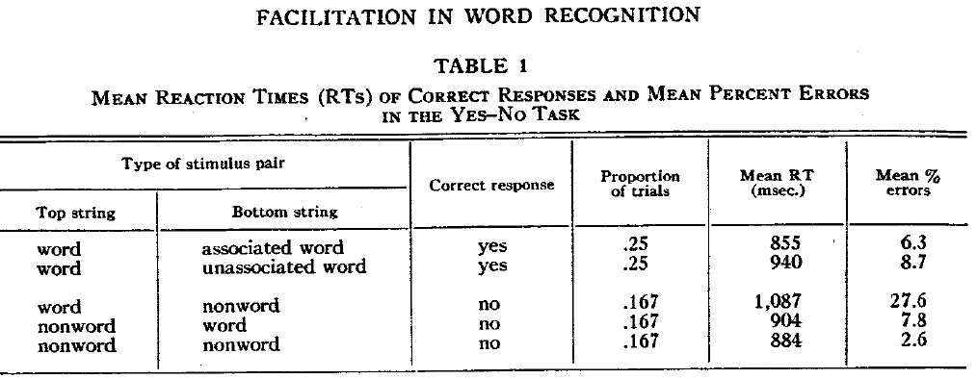
Meyer and Schvaneveldt measured the latency (reaction time) for people to classify the stimuli as words or non-words.
The results are presented below in Table 1:
Source: http://interlinkinc.net/Roger/Papers/MeyerSchvaneveldt1971.pdf

Slide 10
EXERCISES (PART I)
What is the independent variable?
What is the dependent variable?
How does the RT for word-associated word compare with that for word-unassociated word? Why?
For which pair of strings was the RT longest ? Why?
Look at the error rates for all the different combinations. Are there differences?

Slide 11
Experiment II
In a second experiment using the same stimuli, subjects were given a slightly different instruction. They were to press a “same” key if the stimuli were both words or both non-words. They were to press a “different” key otherwise.

Slide 12
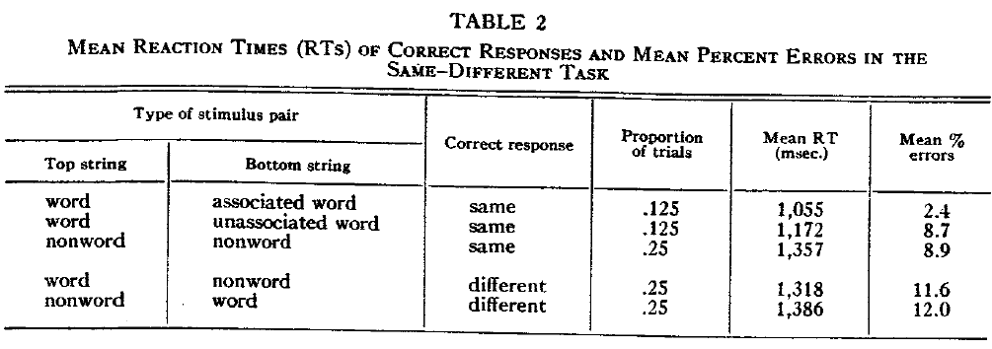
The results appear in Table 2 below:
Source: http://interlinkinc.net/Roger/Papers/MeyerSchvaneveldt1971.pdf

Slide 13
EXERCISES (PART II)
What are the independent and dependent variables?
What are the control variables?
How do “same” responses for pairs of associated words compare with those for pairs of unassociated words? Why do you think we get these findings?

Slide 14
EXERCISES (continued)
How do “same” responses for pairs of unassociated words compare with those for non-words? Why?
How does the error rate for associated words compare with that for unassociated words?
Which experiment is most like the one you did in Psychmate? How do your results compare with those of Meyer and Schvaneveldt?

