Slide 1
Psychophysics: Signal Detection Theory
Experimental psychology
guided-inquiry learning
Module: Psychophysics: Signal Detection Theory
©2018, Dr. B. Rumain & Dr. A. Geliebter, Touro College & University System

Slide 2

MOTIVATION
Situation 1:
Did you ever think your cell phone was ringing,
then to find out that it really wasn’t? How is it
that you heard something that wasn’t there?
We look to psychophysics and signal detection theory, in particular, for the answers.
Psychophysics deals with the relationship between incoming physical stimuli and the responses to them.
Signal detection theory is the theory of the interaction of sensory capabilities and decision-making factors in detecting a stimulus. According to signal detection theory, the detection of a stimulus depends on both the intensity of the stimulus and the individual’s physical and psychological state.

Slide 3
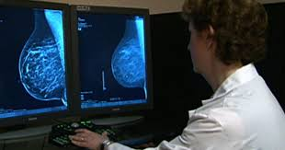
Situation 2:
Let’s take another,
more serious example.
Joann has gone for a
mammogram.
The radiologist sees something on the x-ray but is uncertain whether it is a tumor (in our terminology that would be “signal present”) or whether there is no tumor (in our terminology, that would be “signal absent.”)
In light of the uncertainty, what should he write for the mammogram, tumor or no tumor?

Slide 4
There are serious implications either way. If he writes tumor and there really isn’t one, the woman will get an unnecessary biopsy. If he writes no tumor, and there is one, he might miss the cancer.
So sometimes it is not a black and white situation; some judgment is involved. The judgment he makes depends on his own criterion. The criterion is the internal tool he will follow in making judgments.

Slide 5
Some radiologists won’t want to call it a tumor unless they are certain it is one, thereby preventing unnecessary biopsies and unnecessary expenditures of money. They reason that if there is really a tumor there, it will be picked up on the next mammogram.
Others feel that it is better to have the unnecessary biopsy rather than to miss a tumor. So their judgments, depending on their criterion, will affect their diagnosis
(if they say “yes signal”= tumor present; or
if they say “no signal”= tumor absent).

Slide 6
LEARNING OBJECTIVES
You will understand what is signal and
what is noise.
You will understand what is meant by a criterion.
You will understand the following terms for events regarding the perception of a signal: miss, hit , false alarm, correct rejection.
You will understand how changing the criterion affects the percentages of these events.
You will do an experiment in Psychmate to
gain a fuller understanding of signal detection theory.

Slide 7
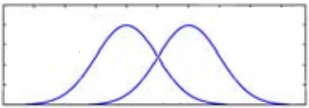
INFORMATION
The Model
The signal detection theory model assumes there are two curves, each represented by a normal distribution. One is for signal. The other is for signal+noise.
Noise signal
Signal+Noise signal
Stimulus Representation
d'
Criterion

Slide 8
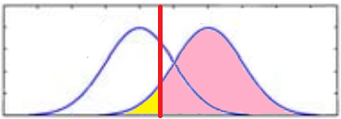
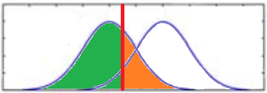
The willingness of the person making the judgment (in our example above, the radiologist) to say “signal present” is a function of the criterion.
For any given criterion, we can identify the following 4 events: hit, miss, false alarm, and correct rejection.
Probability
Criterion response
Probability
Criterion response
correct rejection
false alarm
miss
hit
internal response
internal response

Slide 9
In a hit, there is a signal and the individual correctly says “signal present”.
In a miss, there is a signal but the individual misses it.
In a false alarm, there is no signal, but the individual mistakenly says there is one.
In a correct rejection, there is no signal present, and the individual correctly says there is none.
Probability
Criterion response
Probability
Criterion response
correct rejection
false alarm
miss
hit
internal response
internal response

Slide 10
We can represent this as follows:
Criterion line divides the graph into 4 sections (hits, misses, false alarm, correct rejections).
Probability
Criterion response
 | Signal Present | Signal Absent
Say “Yes” | Hit | False Alarm
Say “No” | Miss | Correct Rejection
miss
hit
internal response
Probability
Criterion response
correct rejection
false alarm
internal response

Slide 11


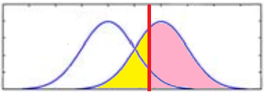
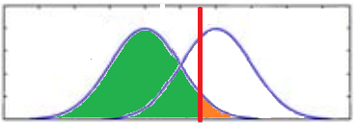
EXERCISES
As the criterion moves to the right, what happens to the number of:
  hits?
  misses?
  false alarms?
  correct rejections?
Click image to see criterion move.

Slide 12
EXERCISES (continued)
As the criterion moves to the left, what happens to the number of:
  hits?
  misses?
  false alarms?
  correct rejections?
Click image to see criterion move.

Slide 13
EXERCISES (continued)
Do the Experiment in Psychmate called Reaction Time Procedures: Stimulus Probabilities
(see pp. 5-8 in Psychmate Student Guide).
In this experiment, you will complete three blocks of trials. In one, the “S” and “H” occur with the same frequency. In another, the “S” occurs 80% of the time, and in the 3rd, the “H” occurs 80% of the time.
Answer the following:
Why is this a signal detection experiment? Explain.

