Slide 1
The Premack Principle
Experimental psychology
guided-inquiry learning
Module: The Premack Principle
©2017, Dr. B. Rumain & Dr. A. Geliebter, Touro College & University System

Slide 2
MOTIVATION
Can you get someone to do something they don’t really want to do? How so?
This is the question this module addresses.

Slide 3
LEARNING OBJECTIVES
You will understand the Premack principle and be able to define it.
You will be able to apply the Premack principle to various situations.

Slide 4
INFORMATION
Model
One online textbook gives the following information relevant to the questions we are trying to answer:
(From Dewey, R. A. (2017) Psychology: An Introduction http://www.intropsych.com/ch05_conditioning/premack_principle.html)
How do you find a reinforcer that will "work" with a particular individual? One technique is to observe what the individual chooses to do voluntarily. As a rule, preferred behaviors can be used to reinforce unpreferred behaviors.

Slide 5
This is called the Premack principle after psychologist David Premack who proposed the rule.
A formal statement of the Premack principle is as follows: high-probability behaviors (those performed frequently under conditions of free choice) can be used to reinforce low-probability behaviors.

Slide 6
What is the Premack principle?
If a rat likes to run on a wheel, you can reinforce a bar-press by allowing it to run on its wheel only after a bar-press.
If you have a hamster that always wants to escape from its cage, then you can reinforce the hamster for climbing onto your hand by offering your hand as a way to escape from the cage. The preferred behavior (escaping) is a reinforcer for the non-preferred behavior (climbing onto the hand of a human). This actually works.

Slide 7
Parents sometimes use a variation of the Premack principle. If they want children to eat vegetables (sometimes a non-preferred behavior) they can make a rule that vegetables must be consumed before the children get to eat a dessert (usually a preferred behavior).
Similarly, children may be asked to do their homework (sometimes a non-preferred behavior) before watching TV or playing video games (usually a preferred behavior).

Slide 8
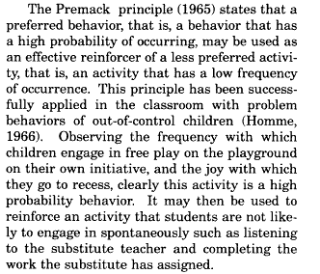
Read the passage below and answer the following questions:
Geiger, B. (1996). A Time to Learn, A Time to Play: Premack's Principle Applied in the Classroom. American Secondary Education, 25(2), 2-6. Retrieved from http://www.jstor.org/stable/41064193

Slide 9
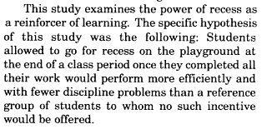

Slide 10

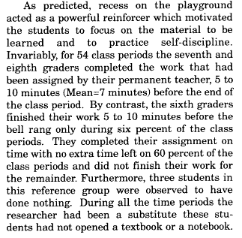

Slide 11
EXERCISES
How is the Premack principle being utilized in the study you read?
What is the independent variable? dependent variable(s)?
Are there any control variables?
What can we conclude was accomplished using the Premack principle?
How do the results support this conclusion?

