Slide 1
The 3-Store Model of Memory
Experimental psychology
guided-inquiry learning
Module: The 3-Store Model of Memory
©2017, Dr. B. Rumain & Dr. A. Geliebter, Touro College & University System

Slide 2
MOTIVATION
Doing well in college involves remembering what the textbook says, what’s said in lectures, remembering how you solved a problem, etc.
All these require memory. But how does memory work? When we “memorize”, what are we actually doing?

Slide 3
LEARNING OBJECTIVES
You will understand the various memory stores: sensory store,
short-term store, and long-term store.
You will understand the properties of each of these.
You will know how we memorize information.
You will learn how to read original research for comprehension and critical thinking.

Slide 4
INFORMATION
The following excerpt is from the research originally done by Atkinson and Shifrin (1968) when they first conceptualized how memory is organized. Read this excerpt and then answer the questions in the exercises.
The entire paper can be found at: http://www.rca.ucsd.edu/selected_papers/2_Human%20memory_A%20proposed%20system%20and%20its%20control%20processes.pdf

Slide 5
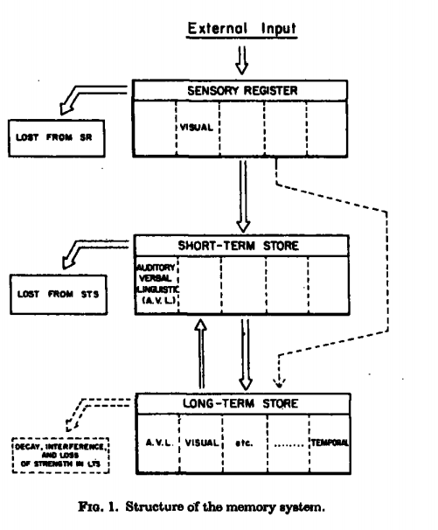

Slide 6
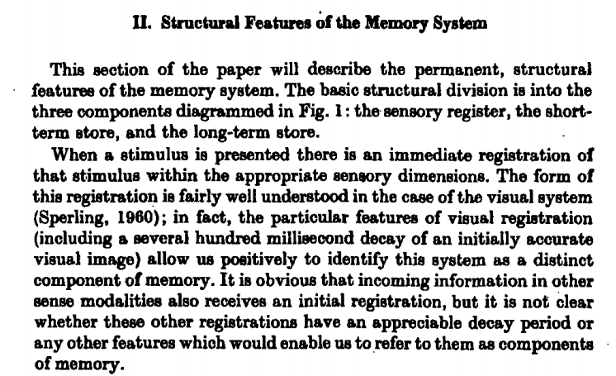

Slide 7
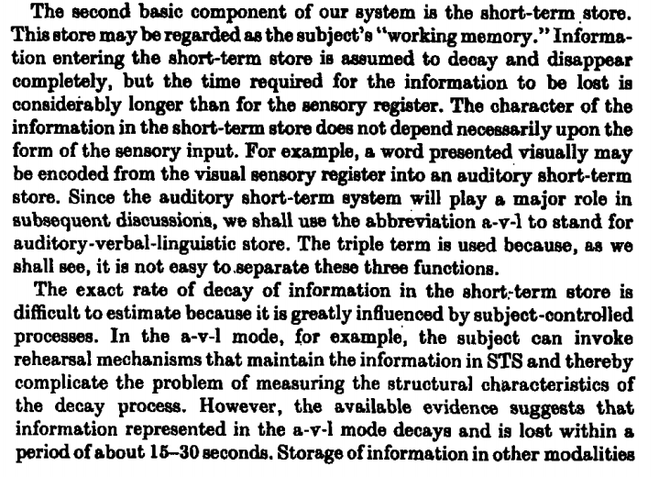

Slide 8
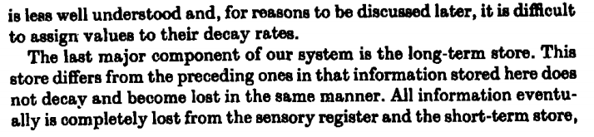
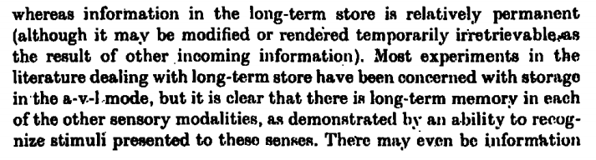

Slide 9
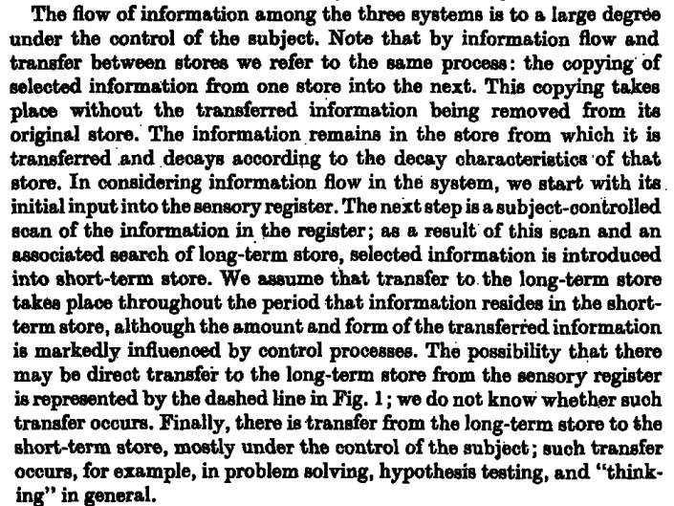

Slide 10
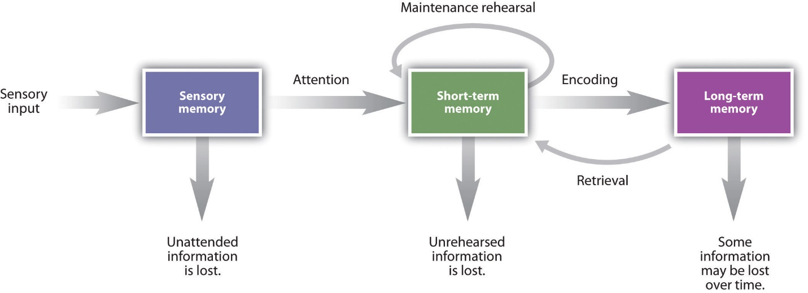
The usual representation of Atkinson-Shiffrin’s work that you will encounter is the following:

Slide 11
EXERCISES
What do they mean by “structural features” and by “control processes”? How do you think these are different?
What are the memory stores?
Which store is the permanent store? What do they mean by “permanent”?
Which are the temporary stores? How do they differ?
What is rehearsal? Why is it a control process?
How long would verbal material last in the short-term store? Give an example from real life that illustrates this process.

Slide 12
EXERCISES (continued)
In the color diagram above, it has "maintenance rehearsal," "encoding," and "retrieval." Look up what each of these terms mean and write down the definitions you find.
Are the concepts embodied in these terms present in the original passage from Atkinson and Shiffrin's seminal work?
From the excerpt, is it possible that information goes not only from short-term store (STS) to long-term store (LTS), but also back from LTS to STS? When does that happen? Give a detailed example.

