Slide 1
Between-Subjects Designs
Experimental psychology
guided-inquiry learning
Module: Between-Subjects Designs
© 2017, Dr. B. Rumain & Dr. A. Geliebter, Touro College & University System

Slide 2
The procedure where participants are randomly assigned to the various conditions so that each subject participates in one and only one condition is called a between-subjects design or independent groups design.
Between-Subjects Design
Independent Groups Design
=

Slide 3
Both of our studies in the last module would be considered examples of between-subjects designs because the subjects in each condition are different from the ones in other conditions.
Another way of saying this is that different groups of subjects are randomly assigned (we’ll explain the “randomly” part shortly) to the conditions.

Slide 4

With this type of design, if you have 90 Subjects and 3 conditions, there are 30 subjects in each condition. If you have the same 90 subjects but only 2 conditions, you would put 45 subjects in each condition.
Between-Subjects Design
90 subjects ÷
3 conditions =
30 subjects per condition

Slide 5
In contrast, in a repeated measures design, you would have the 90 subjects be in one condition and then run them again in any other condition you had in your experiments. That’s why it’s called “repeated measures” because you’re getting repeated measures on the same group of subjects. This type of design, and the matched pairs design, are covered in the next two modules.
Repeated Measures Design
90 subjects =
Run all 90 subjects in each condition (repeatedly)

Slide 6
Random Assignment Using a Between-Subjects Design
Note: In the rest of this module, you are going to set up an experiment using a between-subjects design.
(1) Let’s say you had 90 patients in your depression study. And, let’s say you want to examine the effects of the 3 levels of Elate on your participants. What is the first thing you would do?

Slide 7
The ﬁrst thing you might do is to see whether your 90 patients are basically all the same. For example, if some of them were severely depressed and others were only slightly depressed, then it wouldn’t be fair to treat them as equal:
Suppose you gave Elate to the severely depressed ones and a placebo to the mildly depressed ones. Suppose also that at the conclusion of your study, you ﬁnd that the ones who were given the Elate have moderate depression after their medication regimen.

Slide 8
Obviously, it would not be fair to conclude that Elate is not effective against depression, because patients receiving it ended up moderately depressed, whereas those that received a placebo did better, since they ended up only mildly depressed! That would be ridiculous, since the 2 groups didn’t start out equal in their level of depression to begin with!

Slide 9
Clearly, you’d want to control for level of depression. We’ll get back to this in a little while. In the meantime, let’s assume that all of the 90 patients were equivalent in their degree of depression.
So remember,
Our assumption: All 90 patients are roughly equivalent in their degree of depression.

Slide 10
(2) Let’s say we have 2 treatment groups: 750mg and placebo (0mg). How would you decide which patient is placed in which of the 2 treatment groups?
You would not use any forethought in deciding which subject goes into which group. You just assign each subject randomly.

Slide 11
In order for our experiment to be a true experiment, we must use random assignment in assigning our subject to the various treatment conditions.
Here we have 2 treatment conditions: the Experimental Group and the Control Group.
How do you do the random assignment?

Slide 12
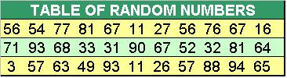
The way to do this is to think of all the patients arranged in a list alphabetically.
Then you go down the list assigning each one a random number. We can then assign patients to “groups” using a table of random numbers like the one below.

Slide 13
As we go down the list of patients, we can use the following assignment rule:
If the random number is even, then the student is assigned to the Experimental Group, the 750 mg. condition;
and if the number is odd, the patient is assigned to the Control Group, the placebo group.

Slide 14
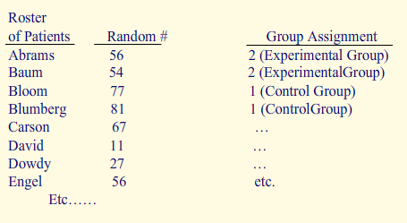
You would do this in the following manner:

Slide 15
Did you know?
Microsoft Excel has a function to produce random numbers and you can use that function to generate your random numbers as well.
Remember, the only time we can say variable A (independent variable) causes variable B (dependent variable) is when we have set up a "true" experiment. By definition, a true experiment is an experiment where we randomly assign Subjects to the level of variable A.

Slide 16
Random Selection vs.
Random Assignment
What is “random selection” and how does it differ from “random assignment”?
A term that is sometimes confused with random assignment is random selection. Random selection means that each member of a population has an equal chance of being selected as a participant in the study to be part of your sample. Also, since each selection is independent of other selections, choosing one person doesn’t affect another person’s chances of being selected.

Slide 17
So, whereas “random assignment” refers to randomly assigning your subjects to conditions once you’ve selected a sample of subjects, “random selection” refers to the fact that the way you come up with your sample of subjects in the first place when you’re selecting them from the population at large must be done in a random fashion as well.
So, if we select a group of 9-year-olds to be in our study, what we are saying with random selection is that the sample of 9-year-olds we’ve selected is representative of all 9-year-olds.

Slide 18
Subject Variables
What is a “subject variable”?
Sometimes, instead of an independent variable, what we have is known as a subject variable. A subject variable, also called a participant variable, is a variable of a subject, such as age, gender, race, ethnic group whose effect we are interested in, but it is not a true independent variable in that we cannot experimentally manipulate it and we cannot assign a subject to a group having a particular subject variable.

Slide 19
For instance, suppose in our study of Elate above, we have reason to believe that Elate would work better for younger subjects than for older ones. And, let’s say we have 2 treatment groups, 750mg and 0 mg (2 levels of the independent variable of dosage).
Now we want to see the effect of age:
We can divide our subjects into 2 groups: people in their 20s-30s, and people in their 40s-50s. Then age would be a subject variable because it cannot be manipulated and it is not assignable.

Slide 20
What this means is that if Harry is 45 years old, he must go into the 40-50 year old group. We have no choice as to where to put him. He has to be in that group by virtue of who he is as a subject, as a person (namely, a 45 year old).
On the other hand, dosage of Elate is a true independent variable because it is a variable we can manipulate; we can decide whether Harry gets the 750 mg. dose or the 0 mg. dose.

Slide 21
Other Possible Designs
An alternative to an independent groups design (= between-subjects design) with random assignment is a repeated measures design, or a matched pairs design, both of which we mentioned briefly above. These are discussed at length in modules that follow.

Slide 22
Exercise
Let’s assume you want to replicate the famous Rosenthal and Jacobson (1968) study. They wanted to see whether self-fulfilling prophecies are true in schools.
A self-fulfilling prophecy is when Person A’s expectations about Person B influences how A acts toward B, which in turn, causes B to behave consistently with A’s original expectation, making the expectation come true.
In their study, they wanted to see whether a teacher’s expectations about a student influences student’s intellectual development.

Slide 23
How do you think you might set up such a study? First, you’d have to find a way to give teachers certain expectations about a student. Think how you might do this.
What would be the independent variable? How many levels would there be of this variable?
What would be the dependent variable? How would you operationalize it, meaning how would you measure the dependent variable?

Slide 24
Answers to Exercises
(1) How do you think you might set up such a study? First, you’d have to find a way to give teachers certain expectations about a student. Think how you might do this.
Rosenthal and Jacobson did the experiment in an elementary school. What they did was administer a test to all of the students and told the teachers that some of the students did so well that they were sure to “bloom” during the coming academic year. They referred to these students as the “bloomers.” But this wasn’t true. What was really true was that these bloomers were chosen randomly using random assignment.
The “bloomers” weren’t any smarter or any more likely to bloom than the “nonbloomers.” The only way in which the “bloomers” did differ was in the minds of their teachers. Neither the students nor the parents were informed about the results of the test.

Slide 25
What would be the independent variable? How many levels would there be of this variable?
The variable of "bloomers" vs. "nonbloomers" was the independent variable. lt had 2 levels (i.e., "bloomers" and "nonbloomers").
(b) What would be the dependent variable? How would you operationalize it, meaning how would you measure the dependent variable?
The dependent variable was student's gain in intellectual development, which could be measured as "IQ points gained."

Slide 26
(c) How would you randomly assign the students to the 2 groups, “bloomers” and “nonbloomers”?
The way to do this is to think of all the students in the class arranged in a list alphabetically. Then you go down the list assigning each one a random number. We can then assign children to “groups” using a table of random numbers (see above).
As we go down the class roster, we can use the following assignment rule: If the random number is even, then the student is assigned to Group 2, the “bloomers” group, and if the number is odd, the student is assigned to Group 1, the “nonbloomers” group.

Slide 27
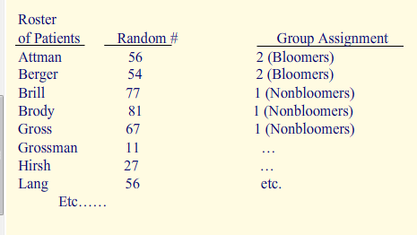
(c) How would you randomly assign the students to the 2 groups, “bloomers” and “nonbloomers”?
of Students

Slide 28
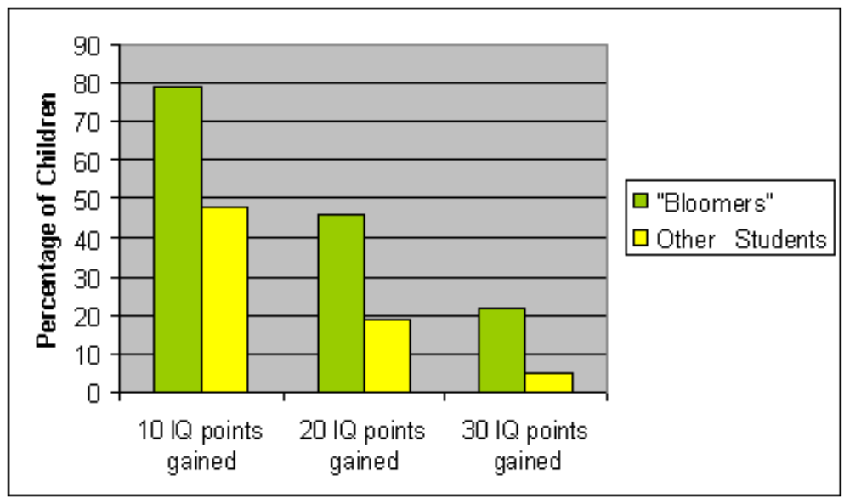
Do you want to know the results of the study?
During the year, Rosenthal and Jacobson would periodically observe class dynamics (i.e., interactions between teacher and students and between students and each other). At the end of the year, all the children were given an IQ test. The results are given below:

Slide 29
As we can see from the graph, no matter what gain of IQ points we look at, whether it be 10, 20 or 30 points, in all cases the bloomers gained more in IQ than the nonbloomers! Teachers’ expectations had become reality!

Slide 30
In looking at class dynamics, it turned out that teachers weren’t consciously giving more attention and encouragement to the bloomers.
But it was found that the teachers unintentionally created a warmer emotional climate for the bloomers, gave them more personal attention, gave them more opportunity to respond and gave them longer to respond in class, and also gave them material to learn that was more difficult.
That teacher expectations influence students’ intellectual development has been termed the Pygmalion effect.

Slide 31

Thought Question
Why would giving the students more difficult material be a good thing? Can you think why? Do you know of the work on enrichment with mice (perhaps from the Intro Psych course) that might be in line with the results here?
As long as the material was not impossibly difficult, just somewhat more challenging, we’d expect the results here because it promotes the bloomers doing more thinking. Dr. Marian Diamond, working with rats, found that providing an enriched environment for the rats resulted in the rats having a thicker cortex, meaning the production of more brain cells! No wonder that the presentation of enriched material results in higher IQ scores!

Slide 32
Sources
Rosenthal, Robert & Jacobson, Lenore (1968). Pygmalion in the Classroom: Teacher expectations and student intellectual development. New York: Holt, Rinehart & Winston.
Rosenthal, Robert & Jacobson, Lenore (1992) Pygmalion in the classroom. Expanded edition. New York: Irvington

