Slide 1
Chi-Square Tests
Experimental psychology
guided-inquiry learning
Module: Chi-Square Tests
©2017, Dr. B. Rumain & Dr. A. Geliebter, Touro College & University System

Slide 2
MOTIVATION
If you want to know whether people prefer Brand X or Brand Y of a product, what sort of test would you use?
Can you use any of the tests we’ve already learned about?

Slide 3
LEARNING OBJECTIVES
You will know when it is appropriate to use a chi-square ( ) test.
You will learn how to calculate chi-square values in doing a chi-square test.
2

Slide 4
INFORMATION
The answer to the above question is that none of the methods we learned allow us to answer the question about the two brands. The reason is that none of the methods we’ve discussed so far are suitable for nominal data – that’s data that falls into distinct categories. All the methods so far are for data that are continuous (these are referred to as ordinal or ratio scales).
So when we want to compare nominal data, we need to use a chi-square test.

Slide 5
Model
Let’s see whether people prefer Cheerios, Honey Bunches, or Raisin Bran cereal. Suppose we conduct a survey and find the following preference distribution:
If people had no preference, we would expect a frequency distribution of 50, 50, 50.
Cheerios | Honey Bunches | Raisin Bran
65 | 45 | 40
Total = 150

Slide 6
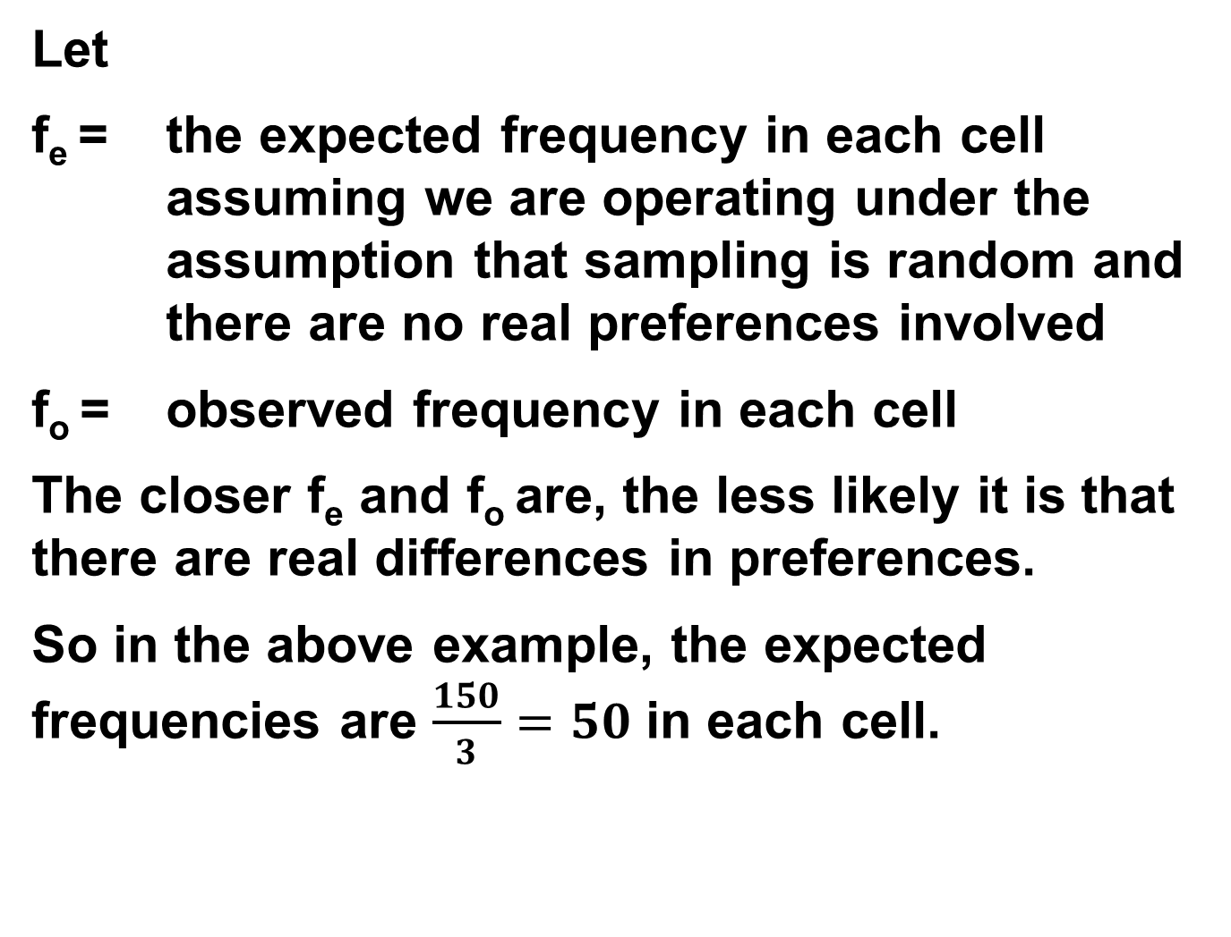
Let
f_{e} = the expected frequency in each cell assuming we are operating under the assumption that sampling is random and there are no real preferences involved
f_{o} = observed frequency in each cell
The closer f_{e} and f_{o} are, the less likely it is that there are real differences in preferences.
So in the above example, the expected frequencies are $\frac{150}{3}=50$ in each cell.

Slide 7
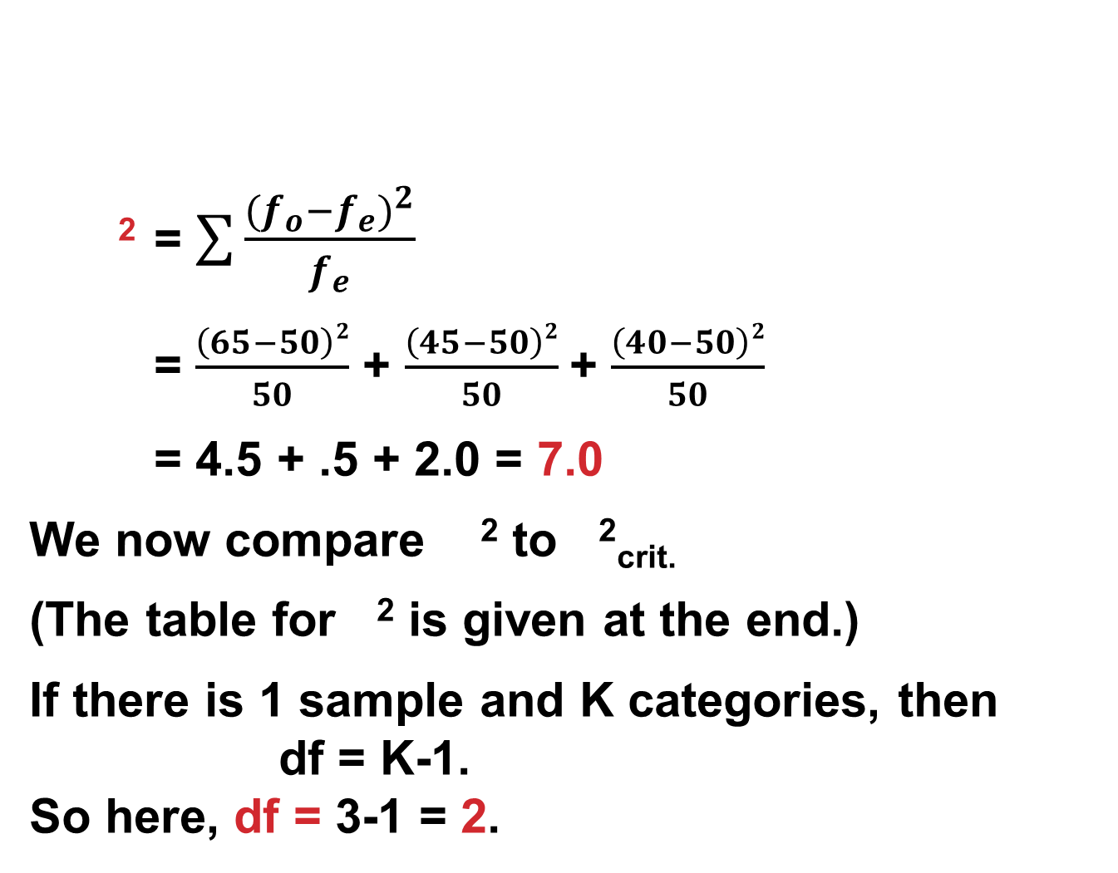
² = $\sum{\frac{{(f_{o}−f_{e})}^{2}}{f_{e}}}$
= $\frac{\left(65−50\right)2}{50}$ + $\frac{\left(45−50\right)2}{50}$+ $\frac{\left(40−50\right)2}{50}$
= 4.5 + .5 + 2.0 = 7.0
We now compare ² to ²_{crit.}
(The table for ² is given at the end.)
If there is 1 sample and K categories, then
df = K-1.
So here, df = 3-1 = 2.
Cheerios | Honey Bunches | Raisin Bran
65 (50) | 45 (50) | 40 (50)

Slide 8
Values of the Chi-squared Distribution
From: https://www.medcalc.org/manual/chi-square-table.php
 | P
DF | 0.995 | 0.975 | 0.20 | 0.10 | 0.05 | 0.025 | 0.02 | 0.01 | 0.005 | 0.002 | 0.001
1 | 0.0000393 | 0.000982 | 1.642 | 2.706 | 3.841 | 5.024 | 5.412 | 6.635 | 7.879 | 9.550 | 10.828
2 | 0.0100 | 0.0506 | 3.219 | 4.605 | 5.991 | 7.378 | 7.824 | 9.210 | 10.597 | 12.429 | 13.816
3 | 0.0717 | 0.216 | 4.642 | 6.251 | 7.815 | 9.348 | 9.837 | 11.345 | 12.838 | 14.796 | 16.266
4 | 0.207 | 0.484 | 5.989 | 7.779 | 9.488 | 11.143 | 11.668 | 13.277 | 14.860 | 16.924 | 18.467
5 | 0.412 | 0.831 | 7.289 | 9.236 | 11.070 | 12.833 | 13.388 | 15.086 | 16.750 | 18.907 | 20.515
6 | 0.676 | 1.237 | 8.558 | 10.645 | 12.592 | 14.449 | 15.033 | 16.812 | 18.548 | 20.791 | 22.458
7 | 0.989 | 1.690 | 9.803 | 12.017 | 14.067 | 16.013 | 16.622 | 18.475 | 20.278 | 22.601 | 24.322
8 | 1.344 | 2.180 | 11.030 | 13.362 | 15.507 | 17.535 | 18.168 | 20.090 | 21.955 | 24.352 | 26.124
9 | 1.735 | 2.700 | 12.242 | 14.684 | 16.919 | 19.023 | 19.679 | 21.666 | 23.589 | 26.056 | 27.877
10 | 2.156 | 3.247 | 13.442 | 15.987 | 18.307 | 20.483 | 21.161 | 23.209 | 25.188 | 27.722 | 29.588

Slide 9
EXERCISES
What is ² measuring when comparing f_{o} and f_{e}?
As the discrepancy between f_{o} and f_{e} increases, what happens to ² ?
Looking at the Table, ² for df = 2 is what value? So this is the value for ²_{crit.}
If ² ≥ ²_{crit.} we assume the results are not due to chance but are significant.
The amount of chance we are willing to accept is called the α level. So if we take α=.05, are our results here due to chance? Explain your reasoning.

