Slide 1
Depths (Levels) of Processing
Experimental psychology
guided-inquiry learning
Module: Depths (Levels) of Processing
©2018, Dr. B. Rumain & Dr. A. Geliebter, Touro College & University System

Slide 2
Motivation
Do we process all verbal material in the same fashion?
No, we do different types of processing depending on the type of information we need from the material we’re processing. Suppose you are shown the word
CHAIR
and are asked these questions:
(1) Is the word in capital letters?
(2) Does the word rhyme with “pear”?
(3) Is the word in the category “furniture”?
How does the processing you do differ for questions (1), (2) and (3)?
Which type of processing do you think would take the longest?
For which type do you think you’d most likely remember that the word was CHAIR?

Slide 3
Learning Objectives
Realize that processing words can involve different types of processing;
Think critically about the degree of semantic involvement in different types of processing tasks;
Read a table that deals with different levels of processing and make correct interpretations about it;
Understand the concept of depths of processing

Slide 4
New Concepts
Depths (levels) of processing
Phonemic processing
Does the word rhyme with “pear”?
Graphemic processing
Is the word in capital letters?
Semantic processing
Is the word in the category “furniture”?

Slide 5
Model
Craik and Tulving conducted an experiment similar to the one described above. Five types of questions were used. They were:
(1) Is there a word present?
(The negative trials for these were blank screens.)
(2) Is the word in capital letters? graphemic
(3) Does the word rhyme with __________? phonemic
(4) Is the word in the category ________? semantic
(5) Would the word fit in the sentence _____? semantic
Craik and Tulving said that questions (1) through (5) were in order of increasing level of processing with (1) requiring the least processing, and (5) the deepest.
Increasing
Depths
of
Processing

Slide 6
Model (Craik & Tulving)
(2) Is the word in capital letters?
Question (2), which is a question about whether the word is in uppercase letters, requires graphemic processing. This means processing letters or written symbols. Graphemic processing is not deep at all.
(3) Does the word rhyme with __________?
Question (3), where we are asked if the word rhymes with another word, requires somewhat deeper processing, called phonemic processing. This is processing involving the phonemes or sounds of a language.

Slide 7
Model (Craik & Tulving)
(4) Is the word in the category ________?
(5) Would the word fit in the sentence _____?
But the deepest processing occurs when we are asked questions that require us to think about the meanings of the word, as we are in Questions (4) and (5). This requires semantic processing, processing involving meaning, and it is the deepest level of processing we can do.
This means that when we process a word for its meaning, we think about it more deeply than if we are just thinking about what the word sounds like or whether it is written in upper- or lowercase letters.

Slide 8

Model (Craik & Tulving)
In Summary…
The more deeply we process material, the more likely it is to remain in memory.
Graphemic
Processing
Phonemic
Processing
Semantic
Processing
Increasing Depth of Processing

Slide 9
Key Questions (on Group Handout)
Explain why (2), (3) and (4) involve graphemic, phonemic, and semantic processing, respectively.
Craik and Tulving gave subjects four positive and four negative instances of each type of question. Why did they have to give both positive and negative instances of each type?
When Craik and Tulving conducted the experiment, they assigned words to each of ten possible combinations of question and answer which was rotated across subjects. What are these 10 combinations? List them.

Slide 10
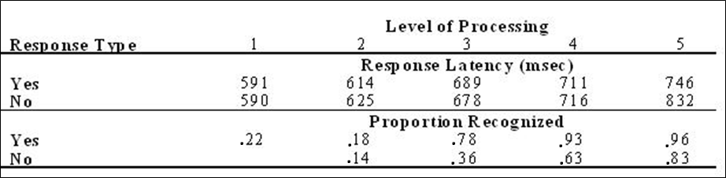
Key Questions (on Group Handout)
4. Craik and Tulving’s data are given in the table below.
What do you notice about response latency (reaction time) as level of processing increased?
What can you say about the proportion of words recognized as level of processing increased?

Slide 11
Key Questions (on Group Handout)
Application to Social Psychology (Questions 5 through 8)
5. For an application of levels of processing theory to Social Psychology, do the experiment in Psychmate called “Levels of Processing and the Self-Reference Effect,” page3-23 in Psychmate, Student Guide. The self-reference effect refers to the finding that subjects demonstrate very good recall when asked to make judgments about whether words describe themselves. Recall on a self-reference task is superior to that on a semantic task. See fig 3.4.2 in Psychmate which illustrates this finding.
In the experiment you do, you will have four levels of processing. Identify what these 4 levels are.

Slide 12
Key Questions (on Group Handout)
6. In Excel, sort your data by level of processing, separately for “yes” responses and separately for “no” responses. Put your data in a table similar to the one above. (Your data will contain only the top half of the table above since you only were in a RT experiment and you were not asked to recall the words as Craik and Tulving did in their original experiment.)
7. What can you say about how percent recall of words studied changes as level of processing increases in your data?
8. Do an ANOVA to test for significance of your results.

Slide 13
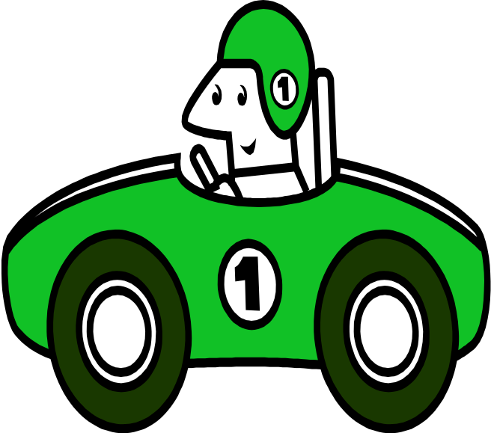
Problem (on Group Handout)
Suppose someone is driving on the highway, reading the road signs, talking on a cell phone with the radio playing in the background (both music and talk). What types of processing are involved in each of these activities? What implications are there in what you learned today for the driver of the car?

